Slide 1
Emotion Recognition from Composed Music using LMMS and DSP Analysis
Presented by: Milan Jani Enrolment No. : 92301733041
Course: DSIP (Digital Signal & Image Processing) Faculty: Dr. Tapan Nahar Institute: Marwadi university

Slide 2
Slide 2 — Introduction
Music carries emotions through rhythm, tempo, pitch and loudness.
Understanding emotions using DSP features is an active research area.
Most research uses large, uncontrolled datasets.
In this project, short clips were analysed to observe how DSP patterns change with emotion.

Slide 3
Problem statement
Existing datasets have mixed recording styles → unpredictable emotional features.
Many models behave like black boxes, giving no clarity on which signal features cause emotion.
Lack of controlled audio samples for clean analysis.
Need a simple method to clearly connect signal behaviour ↔ emotion.

Slide 4
Objectives
Create short emotion-specific clips in LMMS.
Analyse their waveform and spectrogram using Audacity.
Compare loudness, frequency spread and brightness.
Understand how basic DSP changes affect emotional perception.

Slide 5
Software used
LMMS:
For composing 4 music clips (Happy, Sad, Calm, Energetic)
Easy tempo + instrument control
Full manual control → clean observations
Audacity:
For viewing waveform
For generating spectrogram
Screenshot-based DSP study

Slide 6
Methodology
Created 4 short clips in LMMS
Different tempos, instruments, patterns
Exported each clip as WAV
Imported WAV files into Audacity
Observed waveform (loudness changes)
Viewed spectrogram (frequency spread)
Compared all results and noted differences

Slide 7
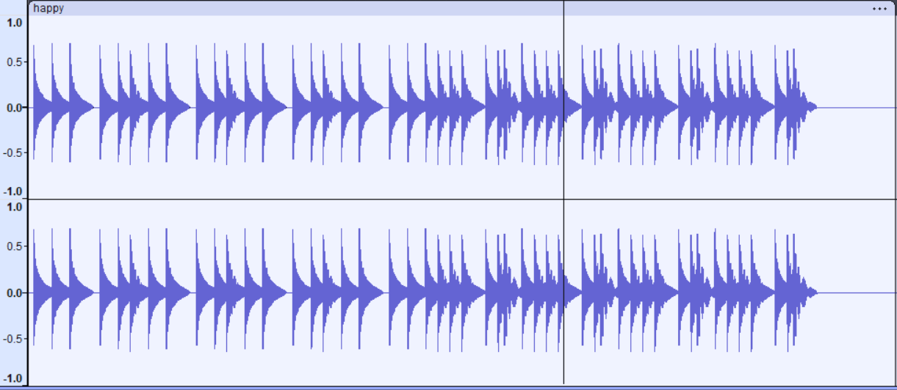
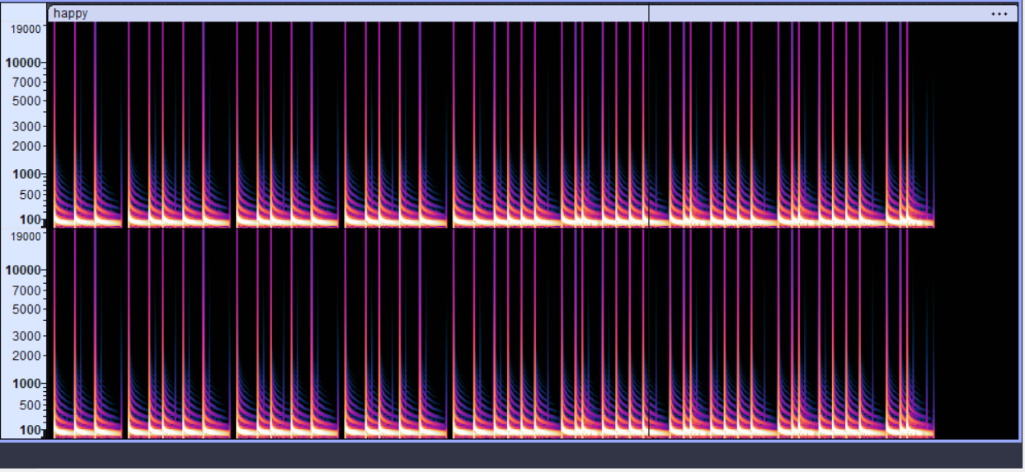
Happy Clip Results
Observations:
Medium-high loudness
Wide frequency range
Bright, active spectrogram
Matches “cheerful” emotion

Slide 8
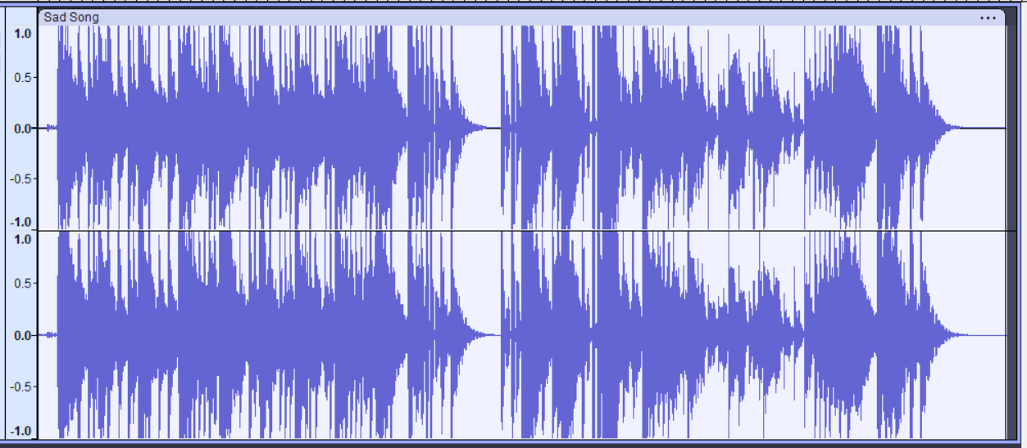
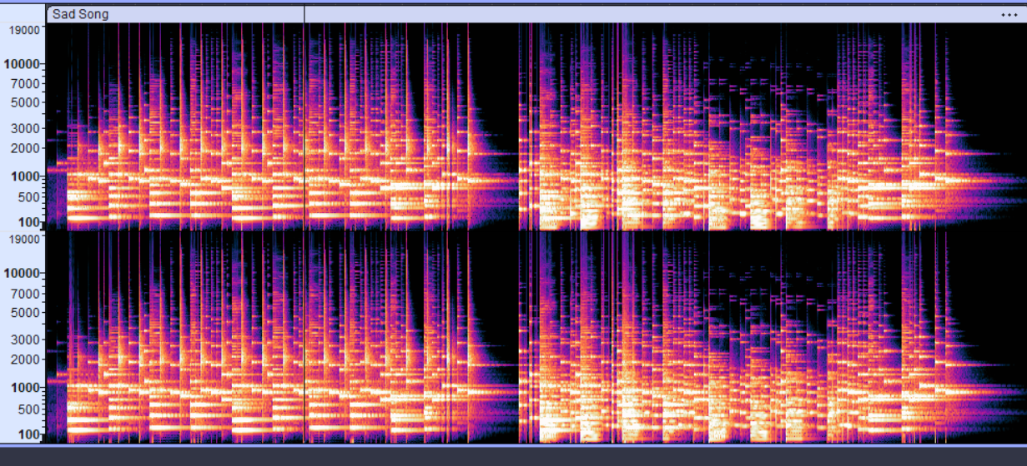
Sad Clip Results
Observations:
Lower loudness
More low-mid frequencies
Darker spectrogram
Slow, emotional feel

Slide 9
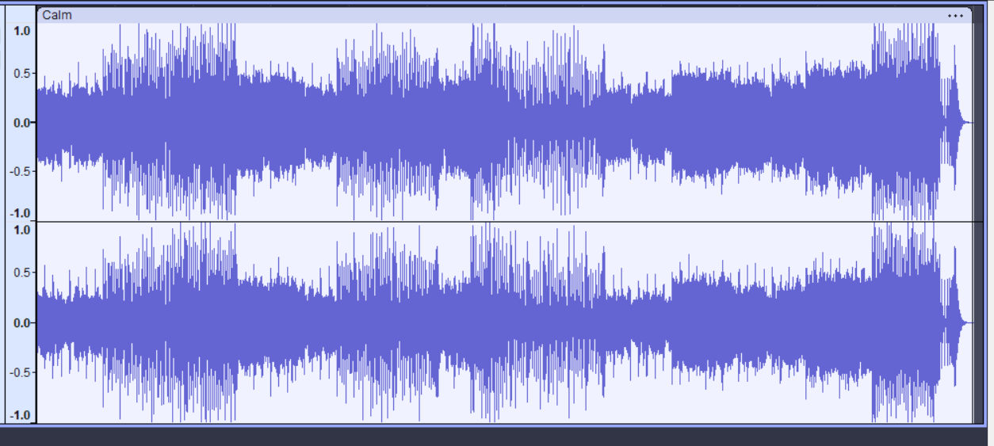
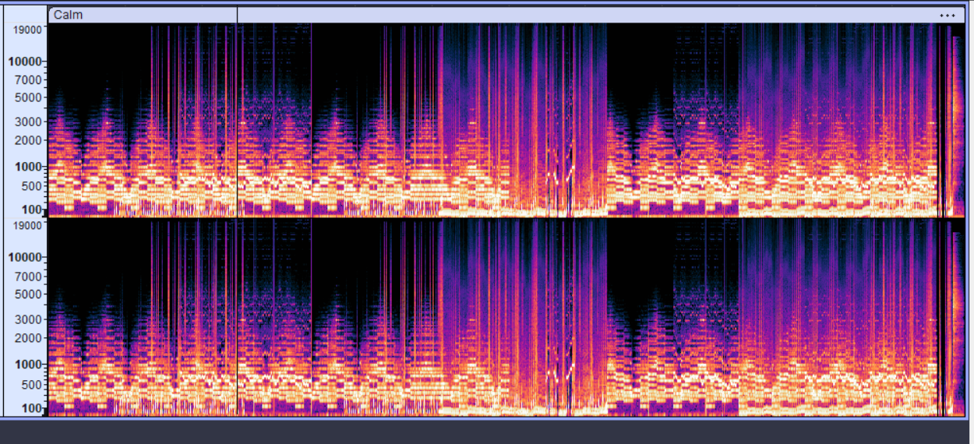
Calm Clip Results
Observations:
Stable waveform
Mid-frequency activity
Smooth & balanced
Matches “relaxed” tone

Slide 10
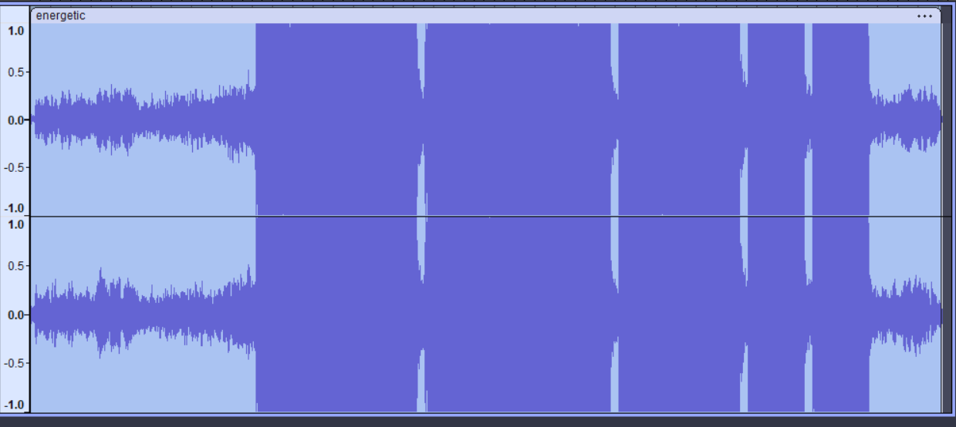
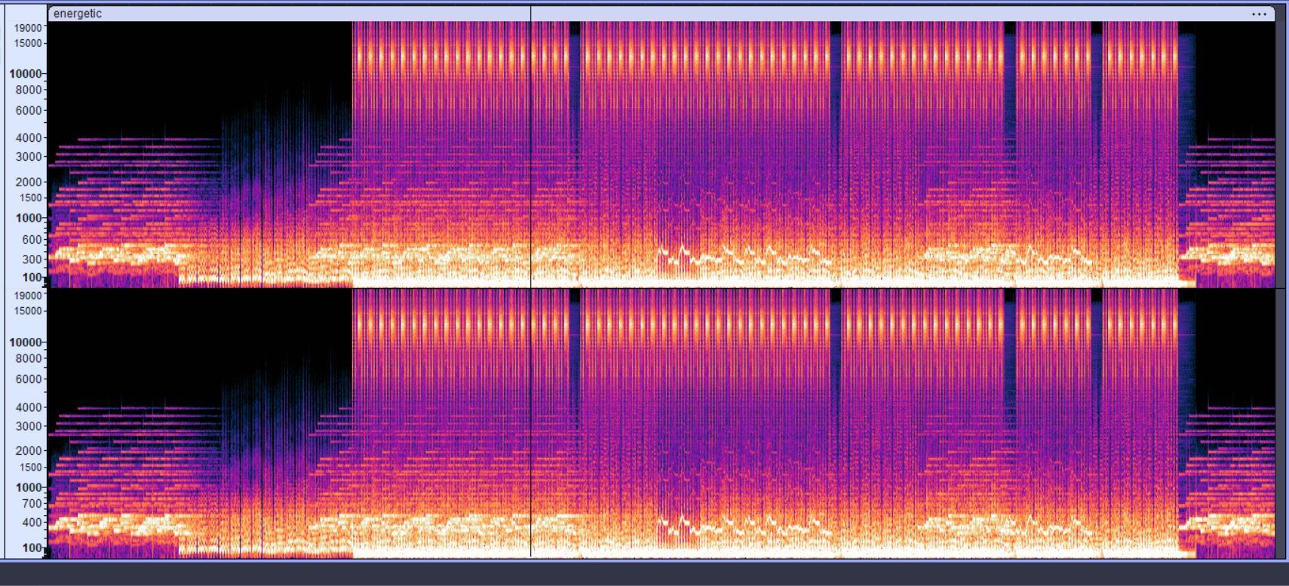
Energetic Clip Results
Observations:
High loudness
Very wide frequency spread
Bright + dense spectrogram
Fast & powerful emotion

Slide 11
Summary table
Emotion | Loudness Pattern | Frequency Spread (Spectrogram) | Brightness / Energy | Overall Interpretation
Happy | Medium to High, Repeating Peaks | Wide spread (Low to High frequencies) | Bright colors, active | Lively and cheerful tone
Sad | Mostly steady, fewer peaks | Mostly low-mid frequencies | Low brightness | Soft, heavy and emotional
Calm | Smooth and even | Mid-range focused | Moderate brightness | Relaxed and peaceful
Energetic | Strong tall peaks | Very broad (full band) | Very bright, dense | Fast, powerful and intense

Slide 12
conclusion
Even small LMMS clips show clear emotional differences in DSP features.
Waveforms & spectrograms reflected the intended emotions accurately.
Simple changes in tempo, loudness, and instrument affect how a clip feels.
Controlled clips help understand emotional behaviour better than mixed datasets.
Can be extended using larger music sets or ML models.

Slide 13
thankyou
Thank you for your attention.

